Slide 1

Digital Electronics and Pulse Technique
Muhaimin Bin Munir

Slide 2
Course Outline
Detailed Course Outline: https://drive.google.com/file/d/1yetQpCgx3YldsFhfCsq9XF-lF1jXSoCr/view?usp=sharing
Week | Lecture | Topic to be Covered
1 | Lec 1 | Overview of switching characteristics of Diodes, Diode Logic (OR and AND) Gates and its operation
 | Lec 2 | Overview of switching characteristics of Transistors, Transistor Gates (NOT, NOR and NAND gates)
2 | Lec 3 | Linear Wave Shaping: High-pass & Low-pass circuits
 | Lec 4 | ...continued

Slide 3
Reference Materials
Jacob Millman & Herbert Taub - Pulse, Digital and Switching waveforms
Jacob Millman - Microelectronics: Digital and Analog Circuits and Systems
Robert F Coughlin & Frederick F Driscoll - Operational Amplifier and Linear Integrated Circuits
Roland J Tocci - Digital Systems Principles and Applications
R.P Jain - Modern Digital Electronics
Youtube Videos
Google
Softcopy of Books: https://drive.google.com/drive/folders/12LLmzfXs4qkqT-j_v4utJUTlz9_CYsim?usp=sharing

Slide 4
6haw5go
Join Google Classroom

Slide 5
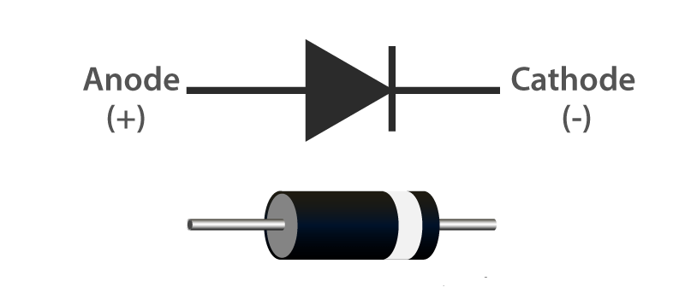
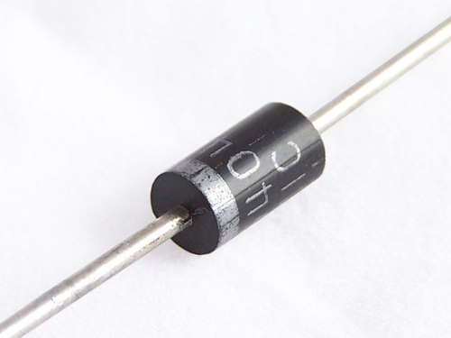
Diode
What is a diode? Diode, an electrical component that allows the flow of current in only one direction. In circuit diagrams, a diode is represented by a triangle with a line across one vertex. Diode Representation

Slide 6
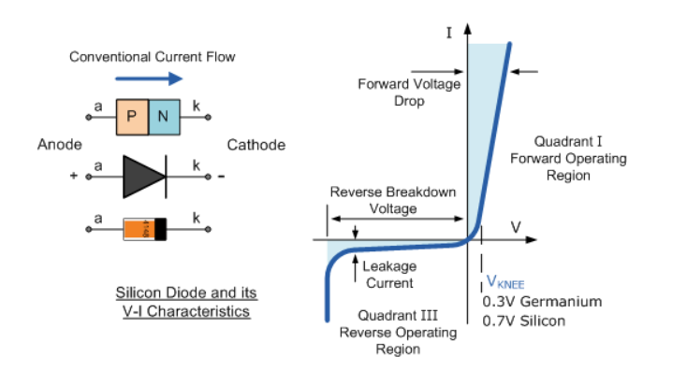
Diode V-I Characteristic Curve

Slide 7
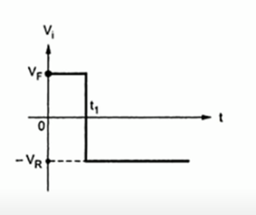
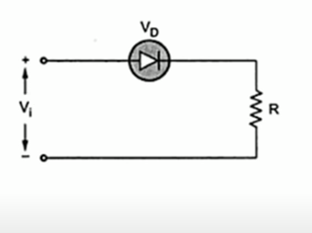
Switching Characteristic of Diode

Slide 8
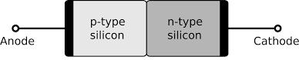
Switching Characteristic of Diode
Assume n-type is heavily doped For open circuit condition under equilibrium
Electrons _{n0} (n_{n0})
Holes_{p0} (p_{p0})
Electrons _{p0} (n_{p0})
Holes_{n0} (p_{n0})

Slide 9
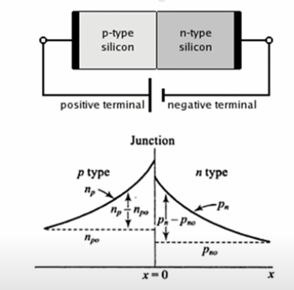
Switching Characteristic of Diode
For Forward Bias condition
Electrons _{n0} (n_{n0})
Holes_{p0} (p_{p0})
Electrons _{p0} (n_{p0})
Holes_{n0} (p_{n0})
Notes:
Minority-carrier density distribution as a function of the distance x from a junction, a forward-biased junction. The injected or excess hole density = p_{n} - p_{n0} (n_{p} - n_{p0})

Slide 10
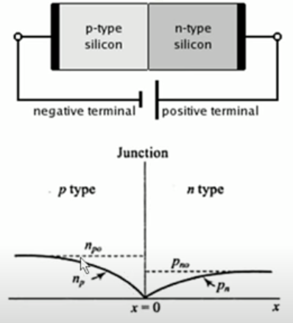
Switching Characteristic of Diode
For Forward Bias condition
Electrons _{n0} (n_{n0})
Holes_{p0} (p_{p0})
Electrons _{p0} (n_{p0})
Holes_{n0} (p_{n0})
Notes:
Minority Carrier density distribution as a function of the distance x from a junction, a reverse-biased junction.

Slide 11
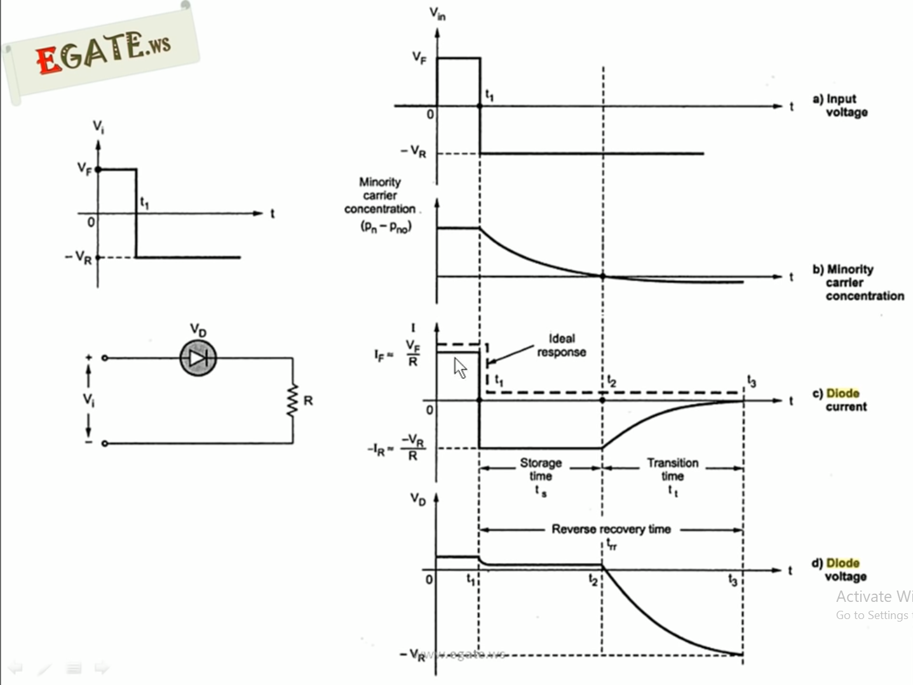

Slide 12
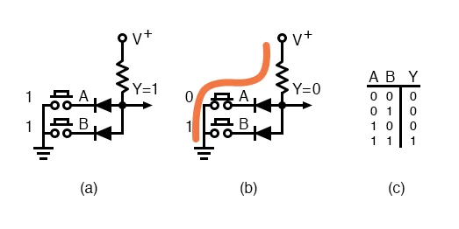
Diode as AND gate

Slide 13
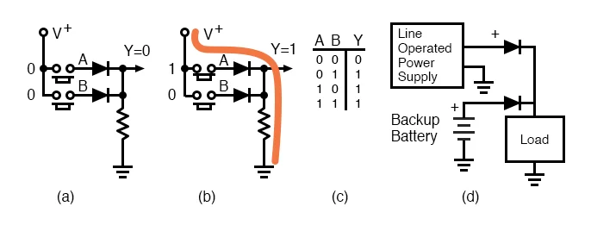
Diode as OR gate

Slide 14
“The most generous among you is the one who spreads what he has learned among people.”
Prophet Muhammad (pbuH)

